Slide 1
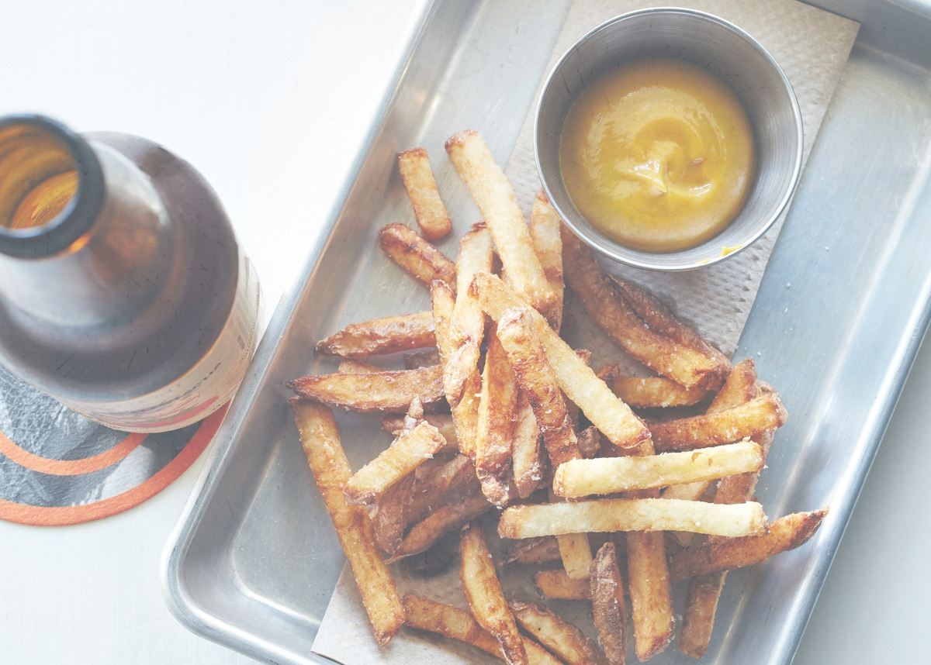
Reciperian
106306001 Vincent Chen
105302055 Ele Hsieh
103303005 Jeremy Chuang
NCCU Data Structure Final Project Group 5

Slide 2


“

Slide 3
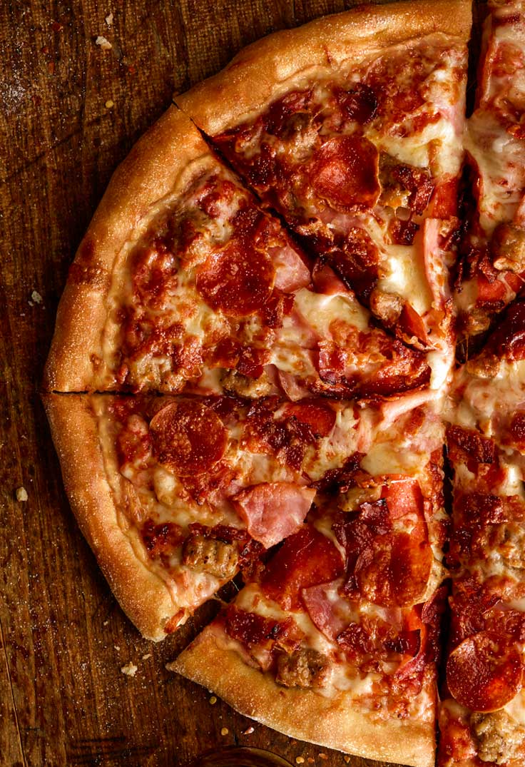
“
Can’t you
FIND THE RECIPE
that you wish to have?
“
“

Slide 4
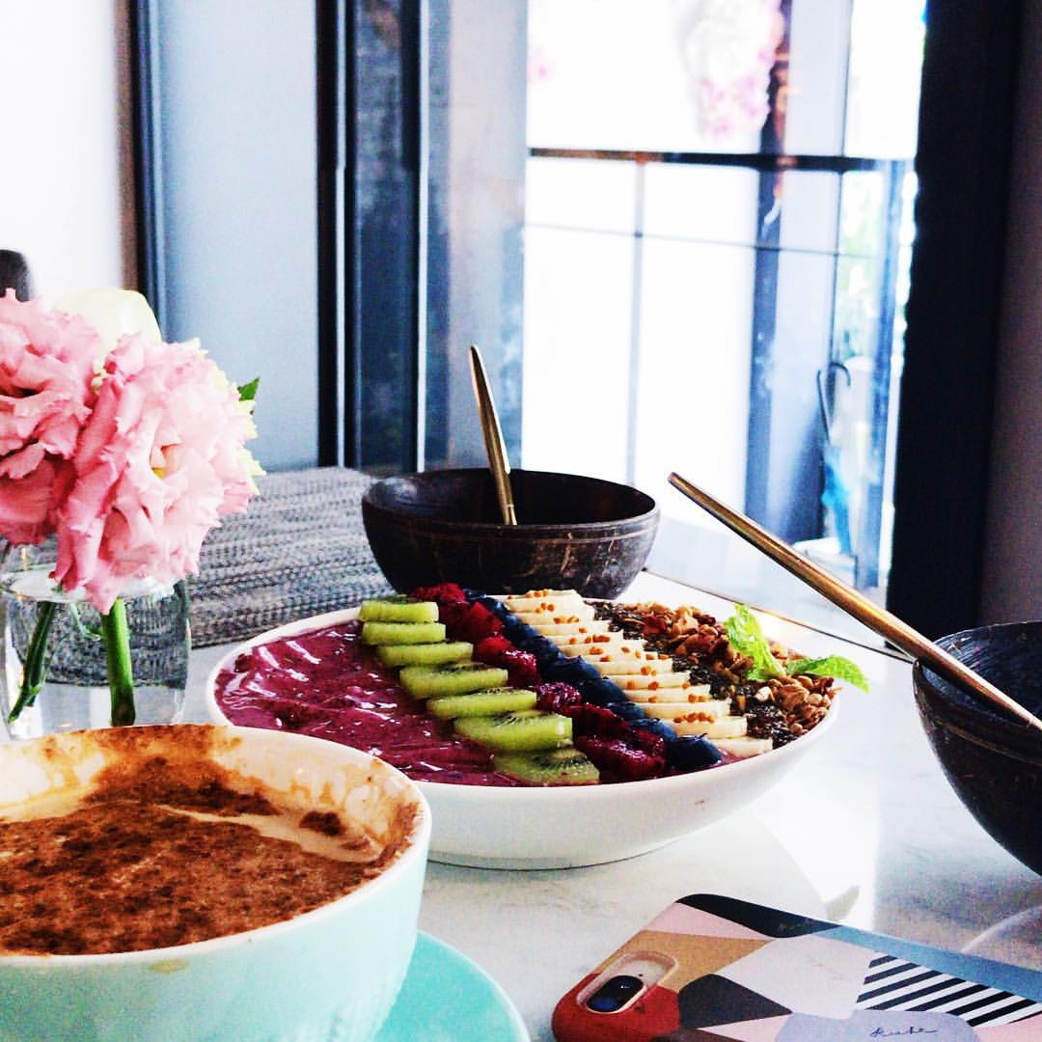
Motivation
We are always frustrated about choosing what to eat for our meal. With this search engine, we ought to get some inspiration.
We can get many similar recipes, and get the best one by ranking the list with some weights.

Slide 5
Accomplished stage
Stage 1: Get the google search result by the keyword (Google Query)
Stage 2: Get the children webpages of the google search results (Google Query)
Based on code provided by TA, we have written the "getLinkScore" object to get all the children webpages and their grandchildren webpages out of the search results by Google.
Stage 3: Build the keyword list which contains the similar keywords and weight them(Keyword, KeywordList)
We have build a list of food that have different weights, ranging from chicken, pork, beef to seafood and so on. We also allow users to input different keywords as well as the ingredients on their own.

Slide 6
Accomplished stage
Stage 4: Rank and sort(Index, GoogleQuery, KeywordHeap, KeywordComparator)
Given the weights and the keywords, we can then store the url, title and weigthed score into Hashmap.
Stage 5: Show the result on website(Search.jsp, googleitem.jsp)
We have leveraged jsp to output our results onto html.

Slide 7
Scoring Formula
Webpage’s Score =
Webpage’s score itself + Children sub webpage's score + Grandchildren sub webpage's score
The count of certain keyword appears in the content of a page’s source code
x
Score =
Keyword’s Weight

Slide 8
Class Diagram
Search.jsp
Googleitem.jsp
KeywordHeap
KeywordComparator
Keyword
Index
GoogleQuery
Back-End
Front-End
WebPage
WordCounter
Web

Slide 9
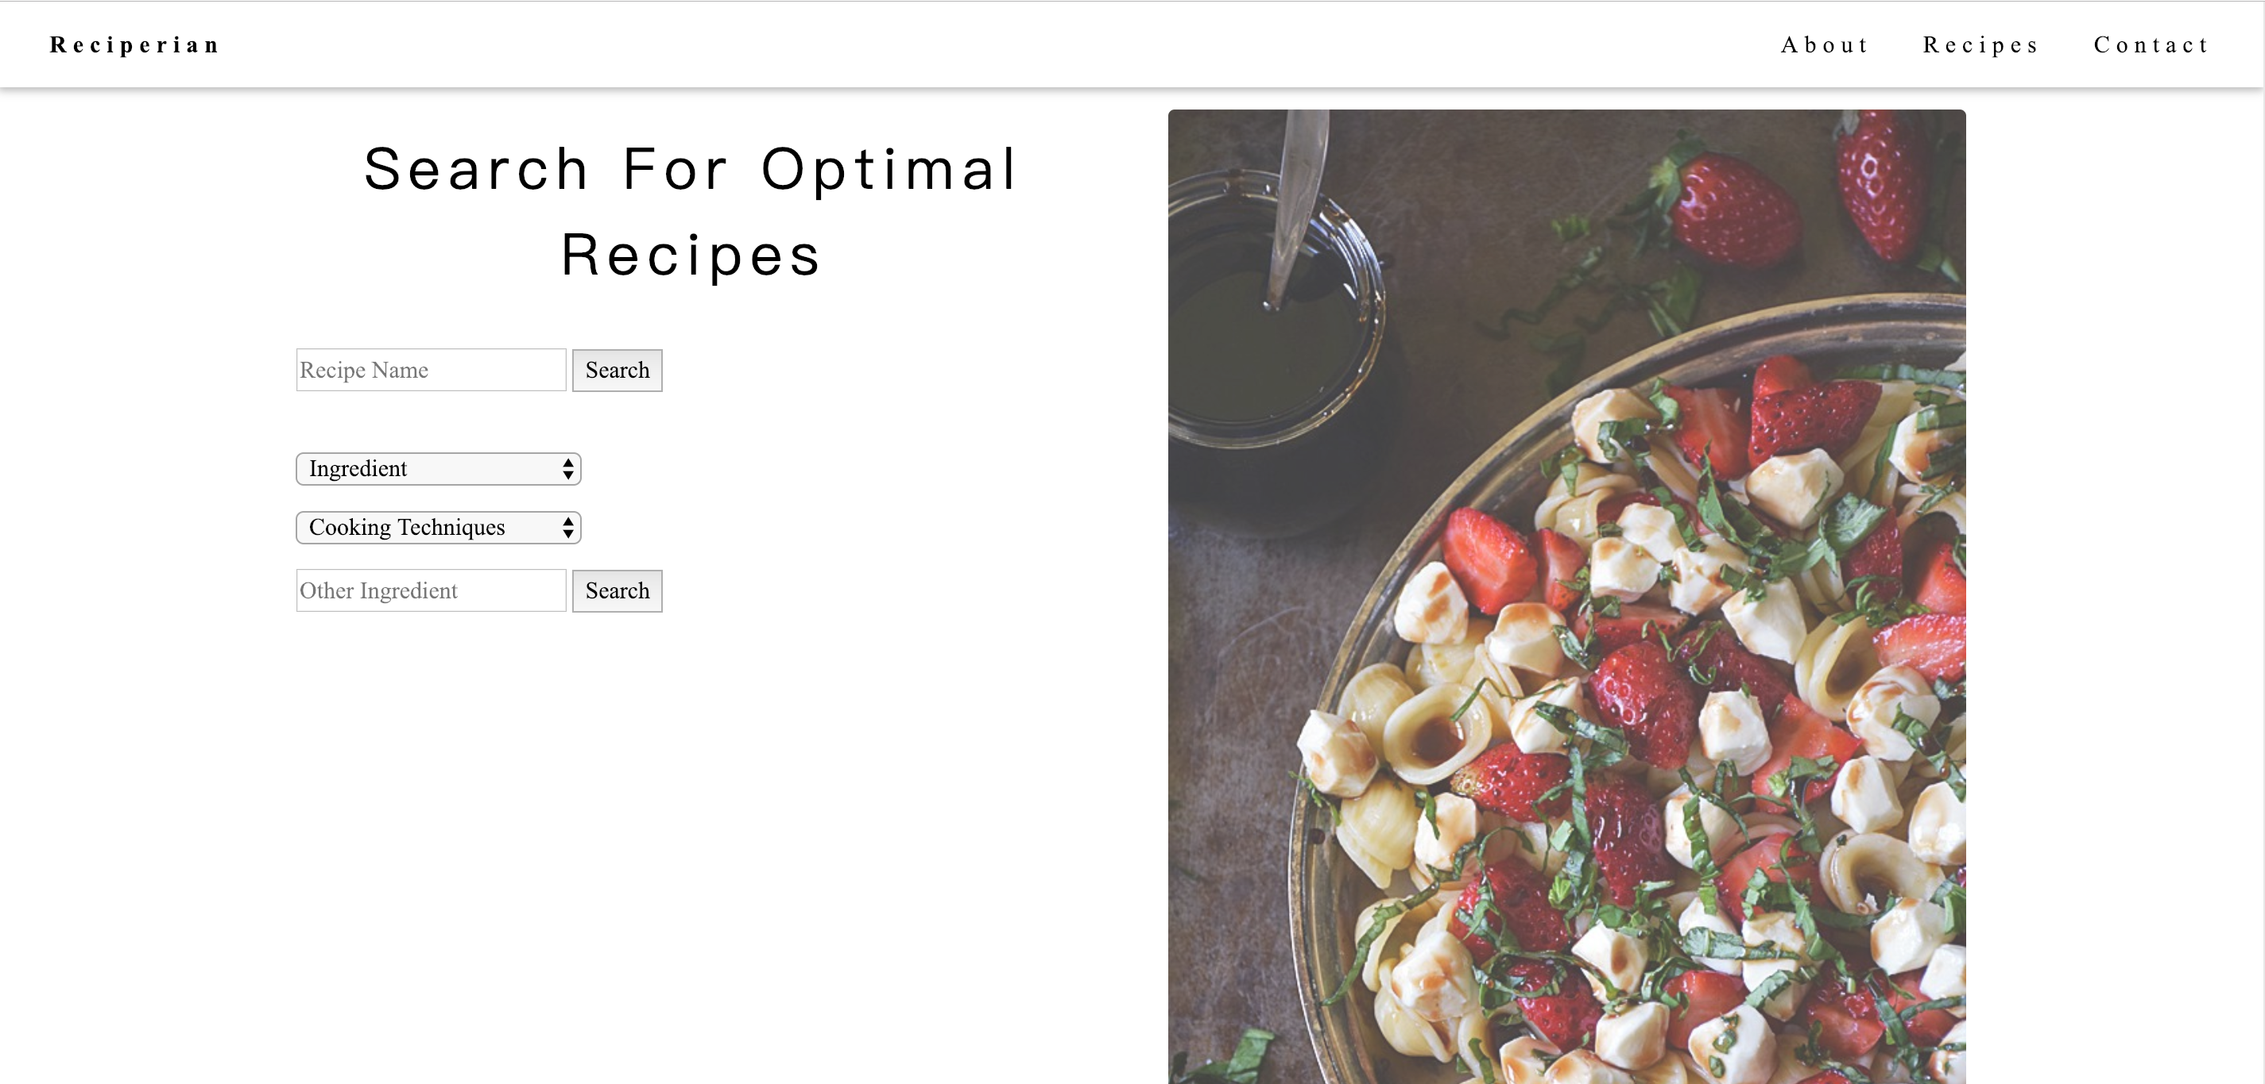
Search Examples

Slide 10
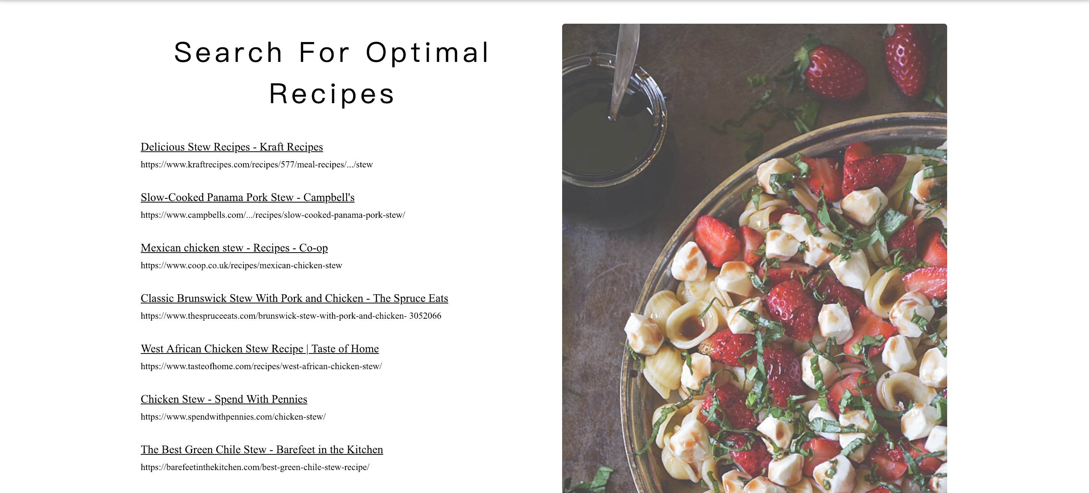
Search Examples

Slide 11
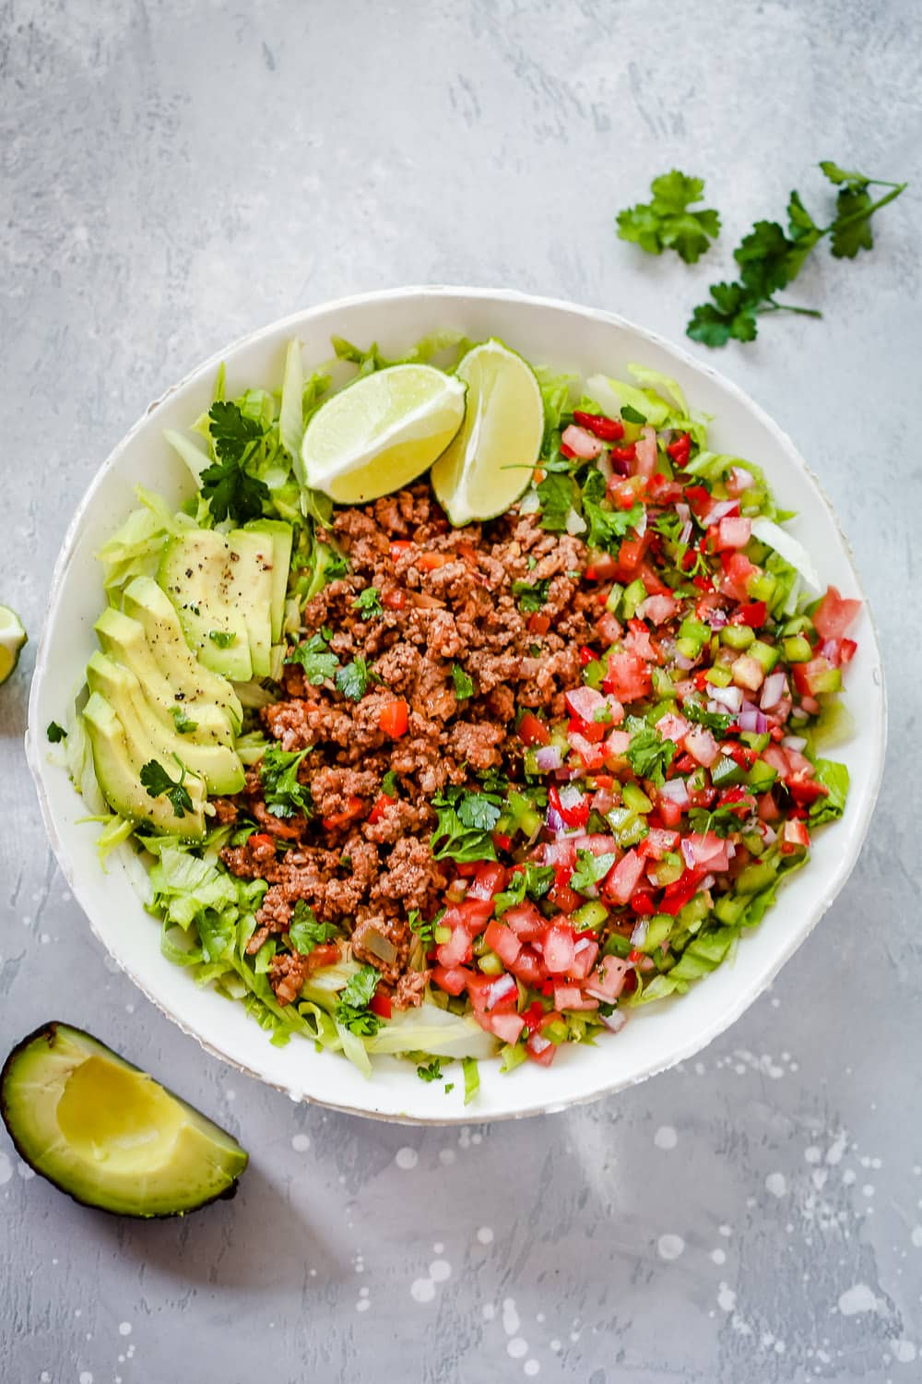
Potential Improvements
Enlarge the keyword list
Implement different weights according to keyword’s html tag
Search for the images in a webpage and fetch those images to display on our searched result

Slide 12
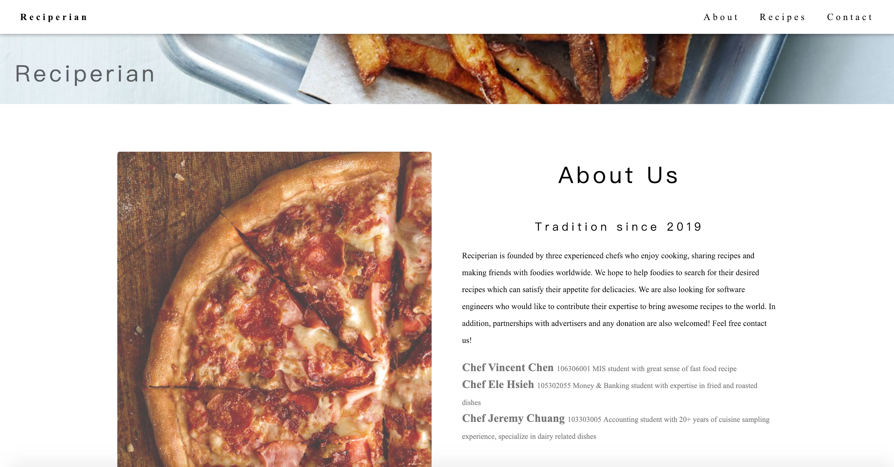
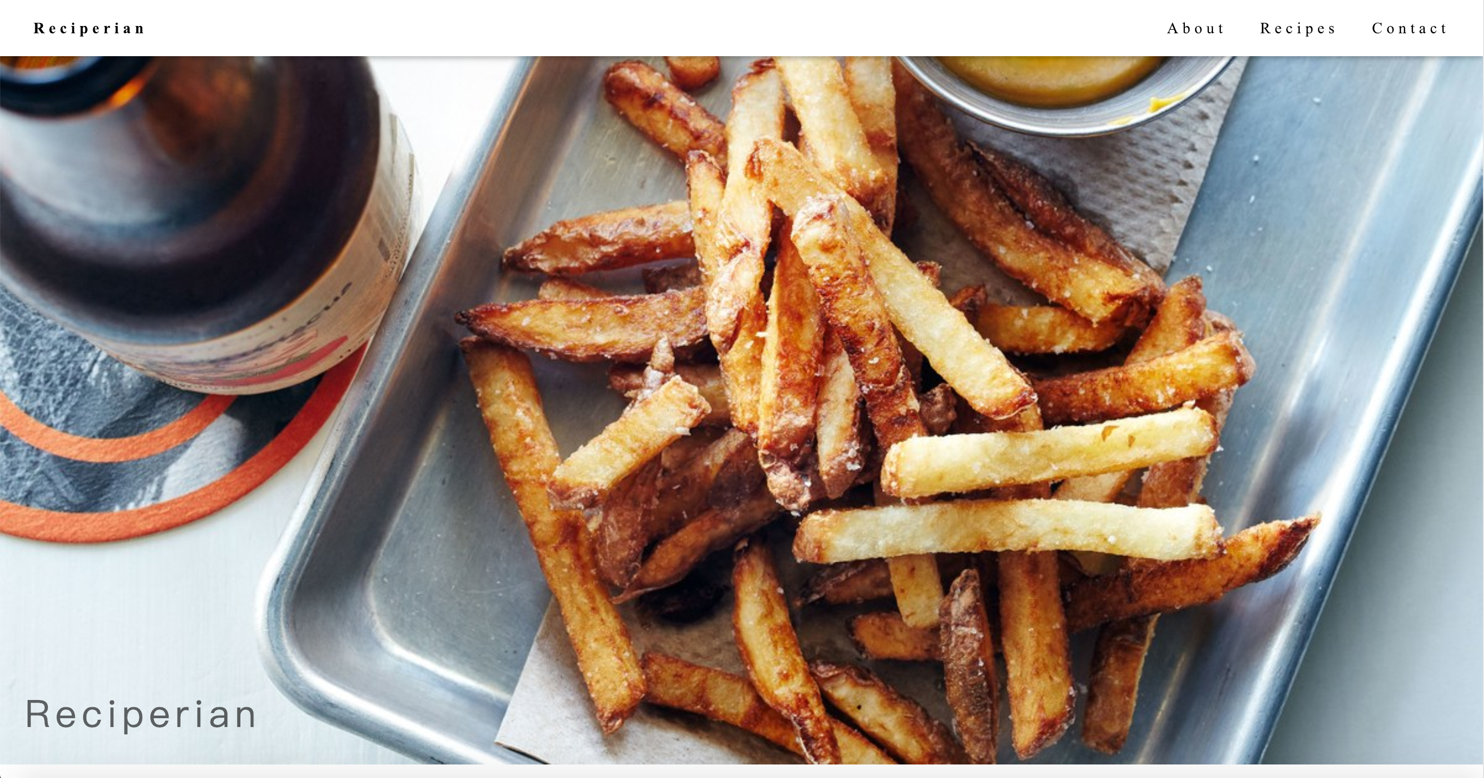
Project Demo

